Slide 1
Huffman Coding
Aryan Garg

Slide 2
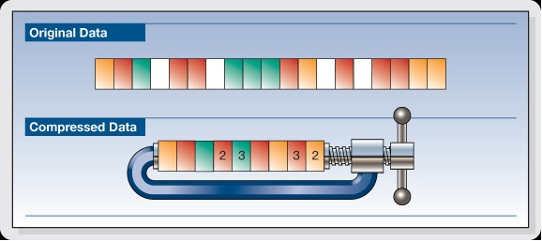
WHat is Compression?
Data compression tries to encode information in such a way that it takes up less space / bits
There is Lossless Compression, where all the data is preserved (useful for example when sending zip files)
Then there is Lossy Compression, where some data is thrown away in an effort to make the file size smaller (ex. In image compression)

Slide 3
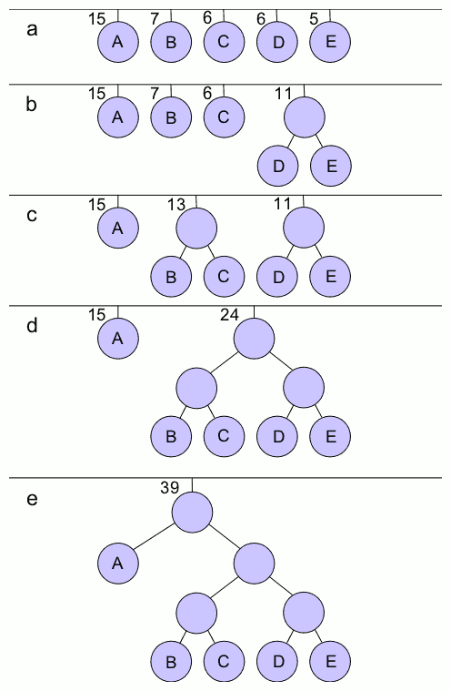
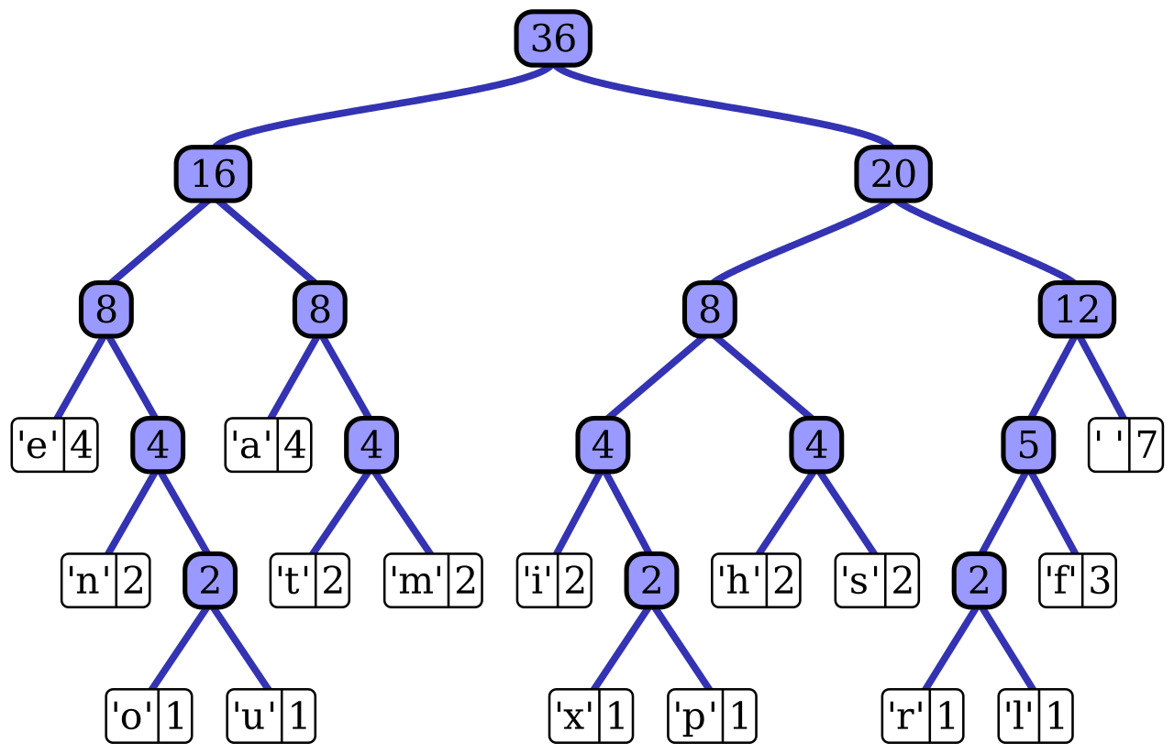
Huffman Encoding
Huffman Encoding is a form of Lossless compression
Huffman Encoding works by encoding commonly found characters in less bits (ex. A = 010) and less common letters in more bits (ex. Z = 0111010)
To find the optimal encoding format, we need to build a huffman tree by arranging all the letters in descending order of how common they appear
Then you assemble the tree by going from the least common letters and combining them

Slide 4
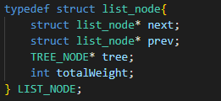
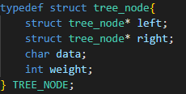
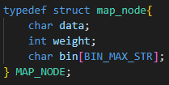
Structure of Program
The program works by first reading in a file and storing all the characters in a Doubly-Linked List and sorting each element as a character “weight” (# of occurrences) is incremented
The program then starts from the back of the linked list and assembles the two least common nodes into a node and resorts the linked list
Carry this on until the linked list is only composed of one node, which contains a tree with all of the characters
After we get the Huffman Tree, it is just a matter of traversing the tree to decode / encode letters
In my code, to speed things up I create a map which links all of the characters to their corresponding Huffman Code

Slide 5
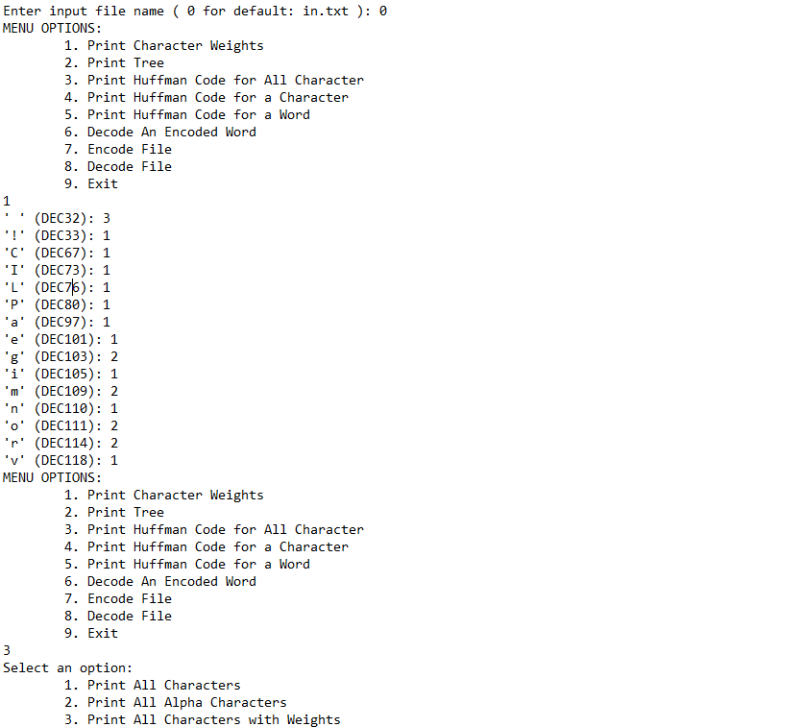
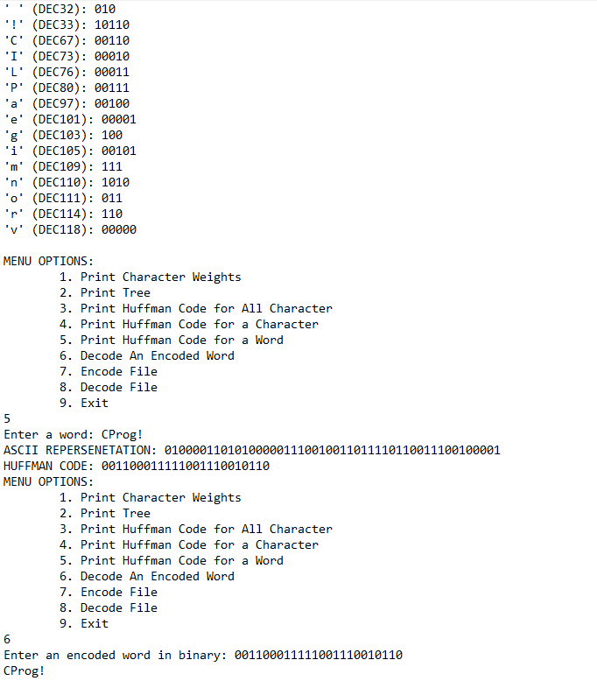

Sample Run

Slide 6
Conclusion
Data compression is a very important concept in Computer Science
Any type of video service will be almost impossible to run without Compression, as compression allows websites like Youtube to store videos at a nearly 1000x smaller rate then without compression)
In this project I was able to explore this vast field of compression through the Huffman Encoding Compression Algorithm, which aims to compress files by letting more common characters take up less space (and less common characters take up more space)

